Slide 1
Interest-based negotiation
Dr. Yumiko Yasuda
Senior Network & Transboundary Water Cooperation Specialist, Global Water Partnership
Presentation at MSP launch workshop

Slide 2
What is Negotiation?
A negotiation is a focused discussion regarding needs and interests, with the intention of finding a mutually acceptable agreement. It is a voluntary action, in which negotiating parties structure the content of their meetings, determine the outcome of their agreements, and stipulate the methods for assuring the implementation of their final decisions.
MRC, 2011

Slide 3
Why Negotiate?
To increase the benefits and reduce the costs compared to the status quo and the predicted future using alternative means
Best Alternative to Negotiated Agreement (BATNA)
Note: Negotiation may not result in outcome
Conditions Favoring Negotiation
Interdependence of parties
Readiness to negotiate and strive for settlement
Some agreement on the issues and some interests
Unpredictability of alternatives to negotiated outcomes
Source: Richard Paisley 2016

Slide 4
Positional Bargaining Approach vs.
Interest Based “Mutual Gains” Approach
Two approaches in negotiation
Source: Paisley 2016

Slide 5
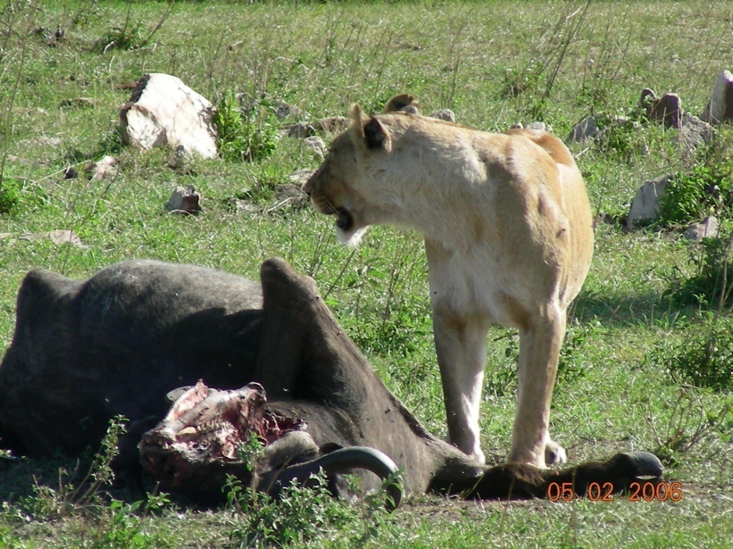
Positional Bargaining
Approach
‘Win-lose’ approach
an ideal solution from one parties perspective
a pre-formed solution
Source: Paisley 2016

Slide 6
Interest Based Negotiations
Rather than dividing the “pie”, Parties work together to build a bigger “pie”.
Source: Paisley 2016

Slide 7
What are interests?
interests are what the parties really want or “need” to get out of a negotiation
they are what motivate a party to negotiate
interests are the needs, hopes, fears, concerns and desires that underlie a position
interests can be substantive, procedural and psychological
Source: Paisley 2016

Slide 8
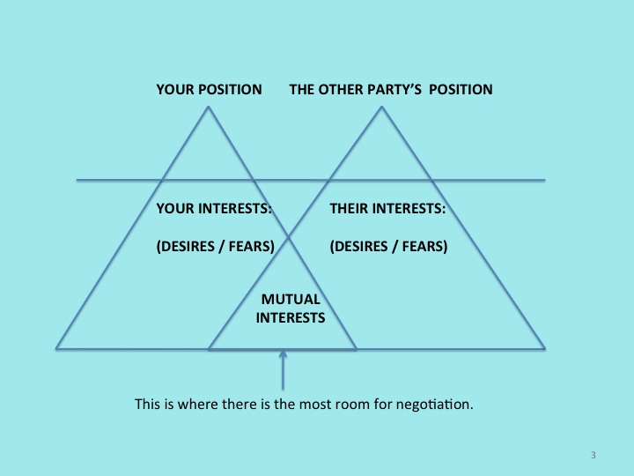
Source: MSP workshop 6 December 2021

Slide 9
Key elements of satisfaction (underlying interests)
Substantive
Psychological, emotional
Procedural

Slide 10
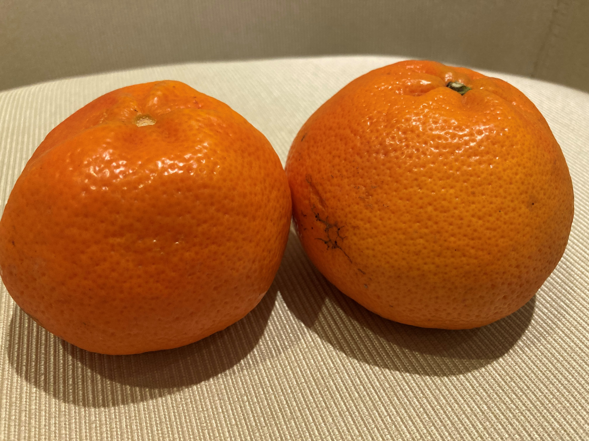
Quiz: Orange disputes
John: owns orange juice factory
Mike: owns orange cake factory
They both need 1 ton of oranges each year to make their business viable. Usually, oranges are plenty, with good price, no competition.
2022 was a drought year, and total orange available in market is 1.2 ton. John and Mike are fighting to get 1 ton of orange to each of them.
What would be out come of ‘position-based’ and ‘interest-based’ negotiations?

